Slide 1

Rights and Freedoms - Union N.L.E.
Monitoring deployment of 1:1 Education in Georgia
Sep’11-Jan’12
Prehistory
Deployment Research Results
Visiting Schools
Highlighted Issues

Slide 2
Rights and Freedoms - Union N.L.E.
Monitoring deployment of 1:1 Education in Georgia
Prehistory

Slide 3
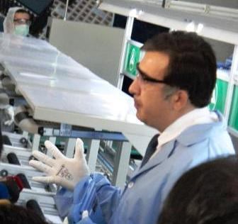
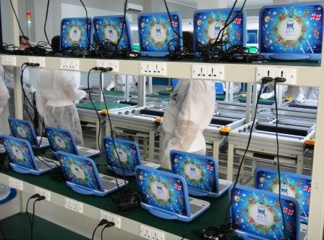
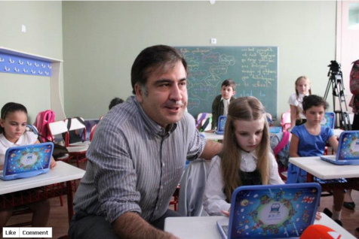
Rights and Freedoms - Union N.L.E.
Monitoring deployment of 1:1 Education in Georgia
1 August 2011 The President of Georgia Mikheil Saakashvili and Minister of Education and Science of Georgia Dimitri Shashkini opened computer factory that has been built by the company “Algorithm”.
Computers - CMPC with name “Buki” were assembled in the local factory and were distributed to the all first grade students and their teachers in September 2011;
Totally Georgia has distributed 52,000 bukies for the 2010-2011 academic year.

Slide 4
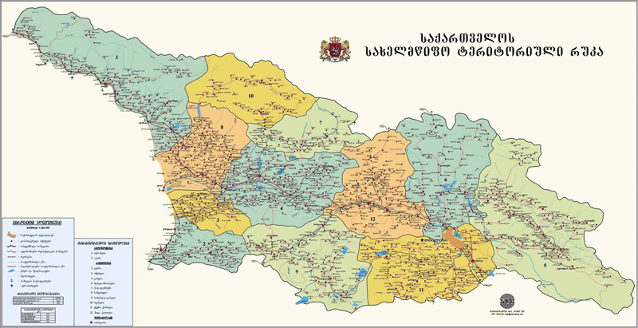
Rights and Freedoms - Union N.L.E.
Monitoring of Teacher Trainings in Georgia
From July’11 till September’1 1 4,200 1st grade teachers in Georgia have been trained on how to use the Bukis through the Master Teacher Program (38 Master Teachers) in 40 regional centers

Slide 5

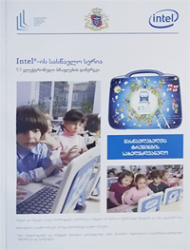

Rights and Freedoms - Union N.L.E.
Monitoring deployment of 1:1 Education in Georgia
Was printed 4,000 Manuals for
teacher trainings
Was printed 52,000 manuals for
Parents
Was Localized Skoool Content the most interactive educational source available on the internet for Georgian students.
This interactive website provides The bundle of lessons, assessments and revision sheets for chemistry, biology, mathematics and English lesson. http://www.skoool.ge

Slide 6
Rights and Freedoms - Union N.L.E.
Monitoring of Teacher Trainings in Georgia
Deployment Research Results
How are you using Bukies
during learning period?

Slide 7
Rights and Freedoms - Union N.L.E.
Monitoring deployment of 1:1 Education in Georgia
Do you use Buki during learning process?
Answer Options |  | Response Percent | Response Count
Yes |  | 71.4% | 1029
No |  | 0.7% | 10
Often |  | 26.4% | 380
rarely |  | 1.2% | 17
answered question |  |  | 1442
skipped question |  |  | 6
How Often do you use Buki for Classroom Learning?
Answer Options |  | Response Percent | Response Count
once in a day |  | 4.0% | 58
Every day |  | 45.6% | 654
once in a week |  | 5.4% | 78
Several times a week |  | 43.4% | 622
not using |  | 0.0% | 0
other |  | 1.5% | 22
answered question |  |  | 1434
skipped question |  |  | 14
*For research of training evaluation was used Surveymonkey source: http://www.surveymonkey.net/

Slide 8
Rights and Freedoms - Union N.L.E.
Monitoring deployment of 1:1 Education in Georgia
On which subject do you use Buki (please select several)?
Answer Options |  | Response Percent | Response Count
Georgian Language and Literature |  | 96.5% | 1384
Mathematics |  | 93.5% | 1341
English Language |  | 60.1% | 862
Natural science |  | 77.6% | 1113
Fine and Applied Arts |  | 83.4% | 1196
Music |  | 65.4% | 938
Other |  | 1.0% | 15
answered question |  |  | 1434
skipped question |  |  | 14
*For research of training evaluation was used Surveymonkey source: http://www.surveymonkey.net/

Slide 9
Rights and Freedoms - Union N.L.E.
Monitoring deployment of 1:1 Education in Georgia
I am comfortable using Buki during lesson
Answer Options |  | Response Percent | Response Count
Stronly agree |  | 30.3% | 434
Agree |  | 63.7% | 912
Disagree |  | 0.2% | 3
Strongli Disagree |  | 5.3% | 76
Have no Idea |  | 0.5% | 7
answered question |  |  | 1432
skipped question |  |  | 16
Children feel comfortable during the lesson through Buki
Answer Options |  | Response Percent | Response Count
Stronly agree |  | 44.9% | 643
Agree |  | 50.7% | 726
Disagree |  | 0.5% | 7
Strongli Disagree |  | 3.7% | 53
Have no Idea |  | 0.2% | 3
answered question |  |  | 1432
skipped question |  |  | 16
*For research of training evaluation was used Surveymonkey source: http://www.surveymonkey.net/

Slide 10
Rights and Freedoms - Union N.L.E.
Monitoring deployment of 1:1 Education in Georgia
Children are bringing charged Bukis at school
Answer Options |  | Response Percent | Response Count
Almost All |  | 83.4% | 1196
Someof them |  | 16.4% | 235
Are not bringing |  | 0.2% | 3
answered question |  |  | 1434
skipped question |  |  | 14
Charged battery is enough during the day
Answer Options |  | Response Percent | Response Count
Yes |  | 58.6% | 841
No |  | 6.7% | 96
Sometimes needs to charge |  | 36.1% | 518
answered question |  |  | 1435
skipped question |  |  | 13
*For research of training evaluation was used Surveymonkey source: http://www.surveymonkey.net/

Slide 11
Rights and Freedoms - Union N.L.E.
Monitoring deployment of 1:1 Education in Georgia
What do you wish for extra learning process improvement (please select several)?
Answer Options |  | Response Percent | Response Count
Printer |  | 38.6% | 553
Projector |  | 68.6% | 983
Interactive board |  | 58.2% | 834
Wi Fi in a classroom |  | 8.0% | 115
Charging shelves |  | 37.4% | 536
Other |  | 1.0% | 14
answered question |  |  | 1433
skipped question |  |  | 15

Slide 12
Rights and Freedoms - Union N.L.E.
Monitoring deployment of 1:1 Education in Georgia
Gained knowledge on the trainings is helping in the learning process
Answer Options |  | Response Percent | Response Count
Stronly agree |  | 56.1% | 806
Agree |  | 41.9% | 602
Disagree |  | 0.2% | 3
Strongli Disagree |  | 1.1% | 16
Have no Idea |  | 0.7% | 10
answered question |  |  | 1437
skipped question |  |  | 11
Do you use Classroom management software
Answer Options |  | Response Percent | Response Count
Yes |  | 43.5% | 619
No |  | 32.2% | 458
Often |  | 8.7% | 124
Rerely |  | 15.6% | 222
answered question |  |  | 1423
skipped question |  |  | 25
*For research of training evaluation was used Surveymonkey source: http://www.surveymonkey.net/

Slide 13
Rights and Freedoms - Union N.L.E.
Monitoring deployment of 1:1 Education in Georgia
Do you use educational software for teachers and students?
Answer Options |  | Response Percent | Response Count
Yes |  | 79.3% | 1134
No |  | 0.2% | 3
Often |  | 20.0% | 286
Rerely |  | 0.5% | 7
answered question |  |  | 1430
skipped question |  |  | 18
Do you make your own worksheets and exercises for children?
Answer Options |  | Response Percent | Response Count
Yes |  | 50.2% | 716
No |  | 15.7% | 224
Often |  | 13.4% | 191
Rerely |  | 20.7% | 295
answered question |  |  | 1426
skipped question |  |  | 22
*For research of training evaluation was used Surveymonkey source: http://www.surveymonkey.net/

Slide 14
Rights and Freedoms - Union N.L.E.
Monitoring deployment of 1:1 Education in Georgia
What improvements do you wish in Buki? (please select several answers)
Answer Options |  | Response Percent | Response Count
More Educational Games |  | 61.8% | 888
Ebooks |  | 43.2% | 621
Adapted curriculum projects |  | 80.5% | 1157
Other |  | 0.8% | 12
answered question |  |  | 1437
skipped question |  |  | 11
*For research of training evaluation was used Surveymonkey source: http://www.surveymonkey.net/

Slide 15
Rights and Freedoms - Union N.L.E.
Monitoring deployment of 1:1 Education in Georgia
Parental involvement in the project is
Answer Options |  | Response Percent | Response Count
Active |  | 55.1% | 790
Partial |  | 42.6% | 611
Passive |  | 2.3% | 33
answered question |  |  | 1434
skipped question |  |  | 14
*For research of training evaluation was used Surveymonkey source: http://www.surveymonkey.net/

Slide 16
Rights and Freedoms - Union N.L.E.
Monitoring of Teacher Trainings in Georgia
Visiting Schools

Slide 17
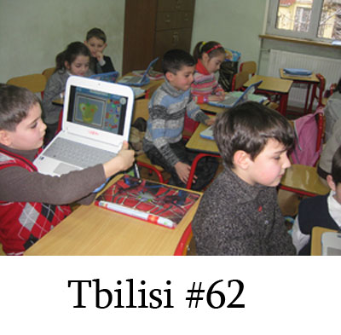
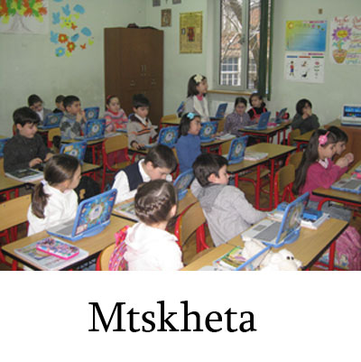
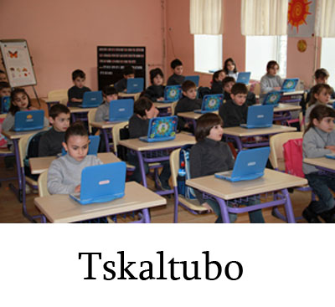
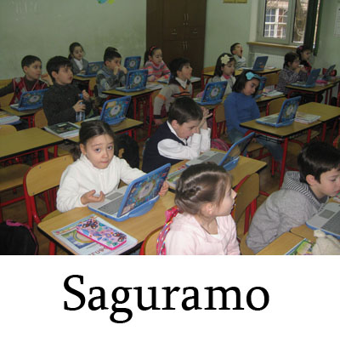
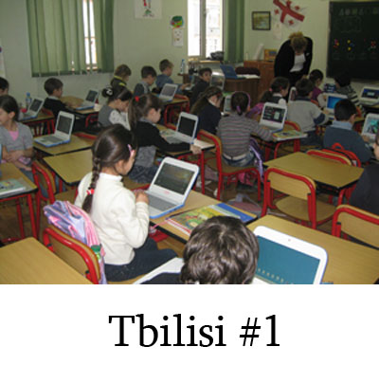
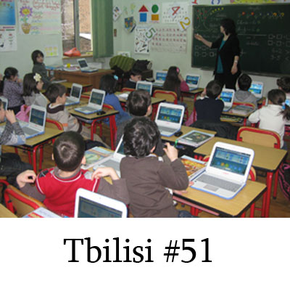
Rights and Freedoms - Union N.L.E.
Monitoring of Teacher Trainings in Georgia

Slide 18
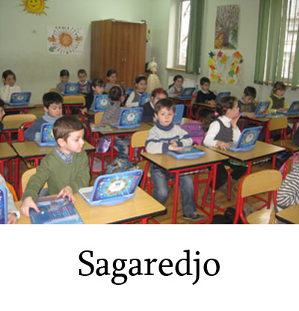
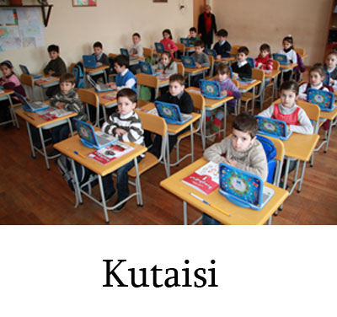
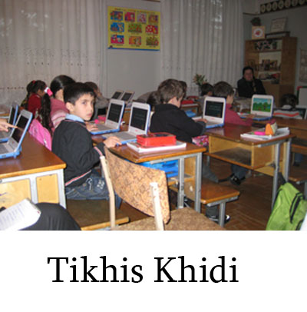
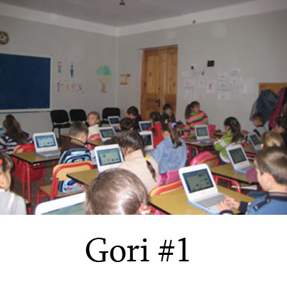
Rights and Freedoms - Union N.L.E.
Monitoring deployment of 1:1 Education in Georgia

Slide 19


Rights and Freedoms - Union N.L.E.
Monitoring deployment of 1:1 Education in Georgia
Class work is devoted to working on the paper, the blackboard and the Buki. Teachers typically use the Bukies as additional tool for 10-15 minutes during the lesson; Lesson time is 35 minute;
Teachers are using educational software on Mathematics, Georgian Language, Natural science and Art lessons;
Many teachers are using their Buki to create simple worksheets in PowerPoint and Word to distribute to students with file sharing help.
Some samples of teacher works:
http://youtu.be/KdIgVacrVEQ Slideshow – Georgian Rtveli

Slide 20


Rights and Freedoms - Union N.L.E.
Monitoring deployment of 1:1 Education in Georgia
Teachers are creating and save question banks with questions and sharing to students via Quiz module.
Some samples of Quiz:
Students are answering with pleasure to questions and sending back to teachers;
Teachers are sharing their desktop through the Classroom Management software, and taking the students through a lesson.
http://youtu.be/XitWLV8m0Kg Some Video from lesson;

Slide 21
Rights and Freedoms - Union N.L.E.
Monitoring deployment of 1:1 Education in Georgia
Highlighted Issues

Slide 22
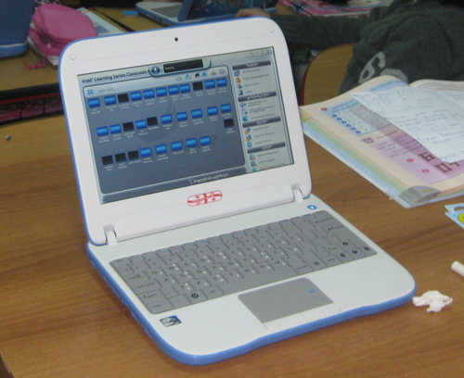
Rights and Freedoms - Union N.L.E.
Monitoring deployment of 1:1 Education in Georgia
Buki’s slow boot time - Booting and connecting to the classroom management software is taking 12-15min.
That’s why teachers need to devote classroom work on the paper and the blackboard.
Battery life — the battery work lasts only 35-50 minutes.
Sometimes teachers are not able to use it on the second lesson.
Buki screen is too small for teachers, it’s hard
to create content on it. It’s small for mythware
screen resolution. We can observe it on the photo.
In the big classes over 20 students, some
Bukies have trouble connecting to the teacher,
for connecting the all students takes about 2-3min.

Slide 23
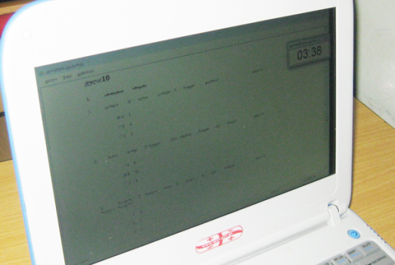
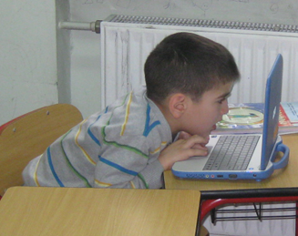
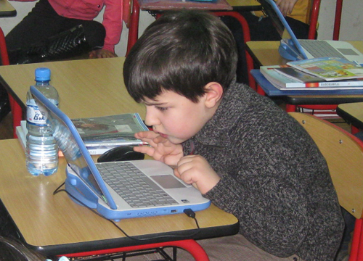
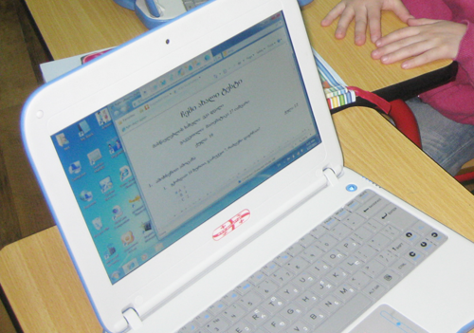
Rights and Freedoms - Union N.L.E.
Monitoring deployment of 1:1 Education in Georgia
Teachers can’t share from their desktops big files and slideshows. In addition, they expressed frustration with the slow refresh rates (10s of seconds) when they share their desktop and sending quiz to students.
http://youtu.be/Y-60sUPkx5U
Received quiz questions on the
students desktops are seen too
small and they are not able to
change font size or make zoom;
After answering and saving questions, Quiz results are shown normally with bigger font size.

Slide 24
Rights and Freedoms - Union N.L.E.
Monitoring deployment of 1:1 Education in Georgia
Thank you!
monitoring@freedom.org.ge

